Slide 1



VIमित्र
VIमित्र
PROJECT
WWW.VIMITRA.COM

Slide 2

CONTENT
01
EVALUATING EDUCATORS
02
SHUTTLE LIVE TRACKING
03
ENHANCING LOGISTICS THROUGH STUDENT ENGAGEMENT
04
UNVEILING THE FLAVORS OF FOOD STALLS
05
EFFECTIVE OUTING TIME MONITORING
06
AUTOMATED WARNING SYSTEM FOR LOW ATTENDANCE

Slide 3


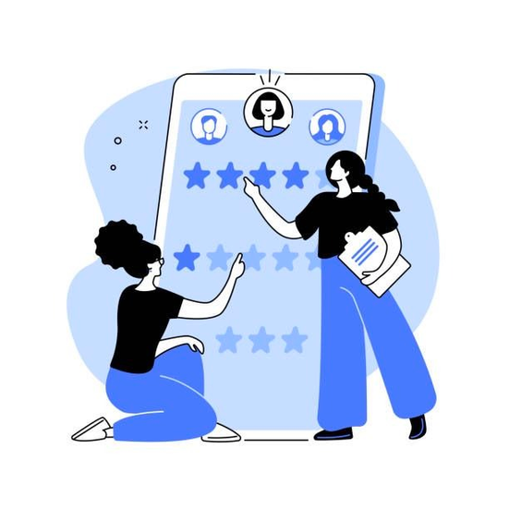
EVALUATING EDUCATORS
Avoid
Verified Feedback: Allow only students who have studied under the respective faculty to provide reviews, ensuring credibility and relevance of feedback.
Performance-based Evaluation: Incorporate performance metrics like grades, attendance, and academic records to provide a comprehensive assessment of educators' impact on student learning.
Confidentiality and Anonymity: Maintain anonymity of students during the evaluation process to encourage honest and unbiased feedback, fostering a safe space for constructive criticism.

Slide 4



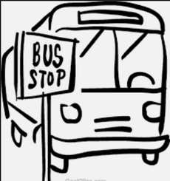
SHUTTLE LIVE TRACKING
Objective n° 1
Objective n° 2
Objective n° 3
The objective of shuttle live tracking is to provide real-time information and visibility of the shuttle buses' current locations and estimated arrival times.
Enhanced Convenience: Users can easily track the location of shuttle buses on a map, allowing them to plan their travel accordingly and minimize waiting time.
Improved Efficiency: Live tracking enables better management of shuttle services by monitoring bus movements

Slide 5


Enhancing Logistics through Student Engagement
01
02
03
04
STEP-1
STEP-2
STEP-3
STEP-4
Notification of Parcel: Students receive a notification informing them that they have a parcel scheduled for delivery today.
Finding Nearby Helpers:
Students open the app and browse for users who are located near the delivery point. The app provides a list of available helpers in the vicinity.
Requesting Assistance: Students select a suitable helper from the list and send them a request to bring the parcel.
Parcel Delivery: Once the helper accepts the request, they proceed to the pickup location, collect the parcel, and deliver it to the intended recipient

Slide 6


UNVEILING THE FLAVORS OF FOOD STALLS
Connecting students with local food stalls, providing information on flavors, prices, and customer reviews.
Gauging Taste and Value: Users can read reviews or ratings from other customers to gain insights into the taste, quality, and overall value of the food.
Discovering Nearby Food Stalls: Users open the app and access the feature that displays a list or map of nearby food stalls and small shops offering various cuisines.
Accessing Detailed Information: Users select a particular food stall or small shop from the list or map and can view detailed information
PROJECT 3
PROJECT 1
PROJECT 2

Slide 7
EFFECTIVE OUTING TIME MONITORING
The Effective Outing Time Monitoring system tracks and records the departure and arrival times of students from the campus. It automatically calculates the duration of their outing. If a student exceeds the allowed time limit, the system sends them a notification alert to ensure compliance. This helps in effectively monitoring and managing student outings while promoting adherence to campus policies.
80%
TIME LEFT

Slide 8

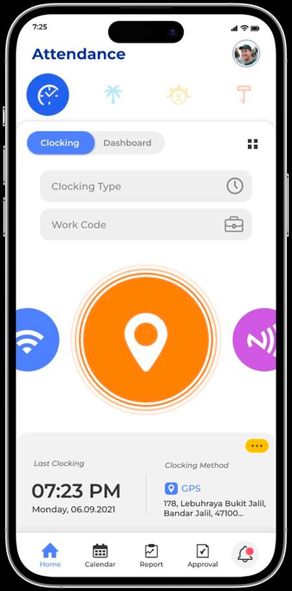
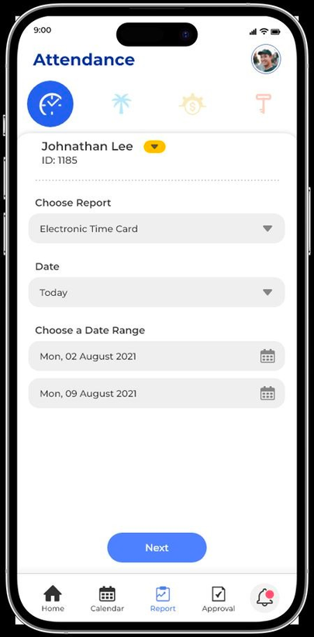

AUTOMATED WARNING SYSTEM FOR LOW ATTENDANCE
Attendance Pre-Notification: Receive a pre-notification on your mobile device if your attendance is projected to be less than 75%.
Bunkable Classes Calculation: Automatically calculate the total number of bunkable classes based on your attendance requirements and current attendance.
Attendance Percentage: Get an accurate and up-to-date percentage of your attendance, allowing you to track your progress and take necessary actions to improve it.

Slide 9
OUR TEAM
Srija Pal
21BCE2307
Aman Kumar
21BCE2276
Vraj Chaudhary
21BCE2239
Everest Cantu
Drew Holloway
Ceo Of Ingoude Company
Ceo Of Ingoude Company

Slide 10

THANK YOU !
VIमित्र

